Slide 1

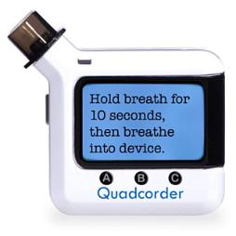
The Quadcorder
#NurseHack4Health
Ivy Pearlstein
Larry Pearlstein
Robin Cogan
Rhonda Manns
May 16, 2020
Notes:
Family NP at FQHC Trenton, NJ
I see patients with COVID-19 every day
Larry EE and our tech guy

Slide 2
Device Concept and system diagram

Slide 3
The Challenge
Technology/remote patient monitoring-home setting
With health care delivery transitioning to the home setting accelerated by this health crisis and widespread stay at home standards, how can technology improve access, efficiency and overall quality of care? (For those unable to seek care elsewhere)
Notes:
we are addressing the technology challenge of remote monitoring in the home setting

Slide 4
The Problem
COVID-19 affects some people very seriously
The vast majority have few or no symptoms and recover completely
Many have symptoms that start mild but progress rapidly to become serious while they remain quarantined at home
Notes:
Some serious- in hospital seen on TV
majority- no symptoms
Many that I see start mild, can progress to serious

Slide 5
Notes:
This is a composite of true experiences my that patients have told me me
get exposed due to No PPE

Slide 6
Notes:
Get sick

Slide 7
Notes:
Doctors offices closed
Pharmacies sold out of thermometers
Worried about infecting their families
worried about getting worse or dying

Slide 8
The Quadcorder measures and transmits four useful indicators for tracking COVID-19 severity
Temperature
Pulse
Oxygen saturation
FEV1
- to the provider
You are OK!!
- to patient
Notes:
our solution is Quadcorder
measures 4 indicators- T,P,O,F
set wirelessly to dashboard in provider office
message sent back to patient to reassure or
GO TO Hospital
Can be a life or death decision

Slide 9
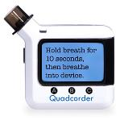
Reduces barriers to care due to social determinants of health
With telehealth providers see more patients
Need to call these patients every few days
Quadcorder provides access to more patients and reduces provider time spent calling patients who are getting better
Can Fed Ex to patient in quarantine
Cost is between $50-$100 per unit
Notes:
Reduces barriers
Reduces calls every few days
Increases provider capacity to monitor
Fed ex
cost

Slide 10
Device Concept and system diagram

